Slide 1
Search Algorithms
Uninformed Blind search
  Breadth-first
  uniform first
  depth-first
  Iterative deepening depth-first
Informed Heuristic search
– Greedy search, hill climbing, Heuristics
Important concepts:
  Completeness
  Time complexity
  Space complexity
  Quality of solution

Slide 2
Uninformed search
Also called blind search.
The term means that the strategies have no additional information about states beyond that provided in the problem definition.
All they can do is generate successors and distinguish a goal state from a non-goal state. All search strategies are distinguished by the order in which nodes are expanded.
Strategies that know whether one non-goal state is “more promising” than another are called informed search or heuristic search strategies

Slide 3
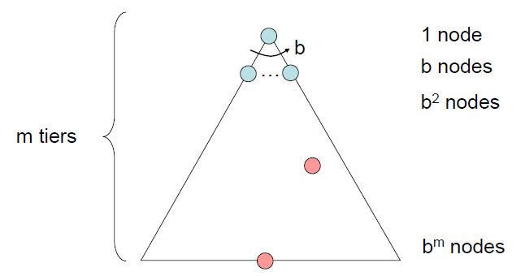

Search Strategies
A search strategy is defined by picking the order of node expansion
Strategies are evaluated along the following four dimensions:
  Completeness: does it always find a solution if one exists?
  Time complexity: number of nodes generated or expanded during execution
  Space complexity: maximum number of nodes or memory required to store the expanded nodes.
  Optimality: does it always find a least-cost solution?
Time and space complexity are measured in terms of
b: maximum branching factor of the search tree
d: depth of the least-cost solution
m: maximum depth of the state space (may be ∞)

Slide 4
Breadth-First (Tree) Search
Strategy: expand the shallowest node first
Implementation: Frontier is a FIFO queue
a
G
b
c
d
e
f
S
h
p
q
r
S
d
e
p
Search
Tiers
b
c
e
h
r
q
a
a
h
r
p
q
f
p
q
f
q
c
G
q
c
G
a
a

Slide 5
Example: Map Navigation
State Space:
S = start, G = goal, other nodes = intermediate states, links = legal transitions
A B C
S
G
D
E
F

Slide 6
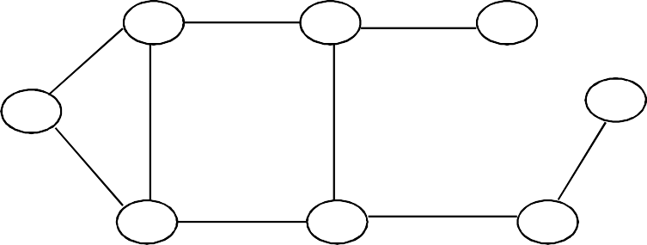
BFS Search Tree
A
B
C
S
G
S
D E F
Queue = {S} Select S Goal(S) = true?
If not, Expand(S)

Slide 7
BFS Search Tree
A
B
C
S
G
S
D E F
A
D
Queue = {A, D} Select A Goal(A) = true?
If not, Expand(A)

Slide 8
BFS Search Tree
A
B
C
S
G
S
D E F
A
D
Queue = {D, B, D} Select D
Goal(D) = true? If not, expand(D)
B
D

Slide 9
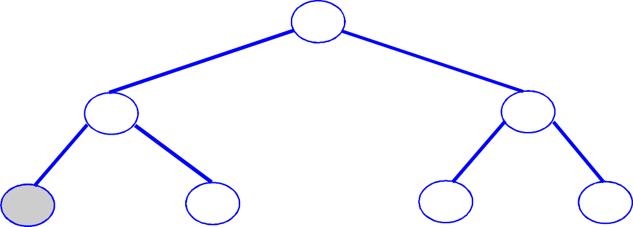
BFS Search Tree
A
B
C
S
G
S
D E F
A
D
Queue = {B, D, A, E}
Select B etc.
B
D
A
E

Slide 10
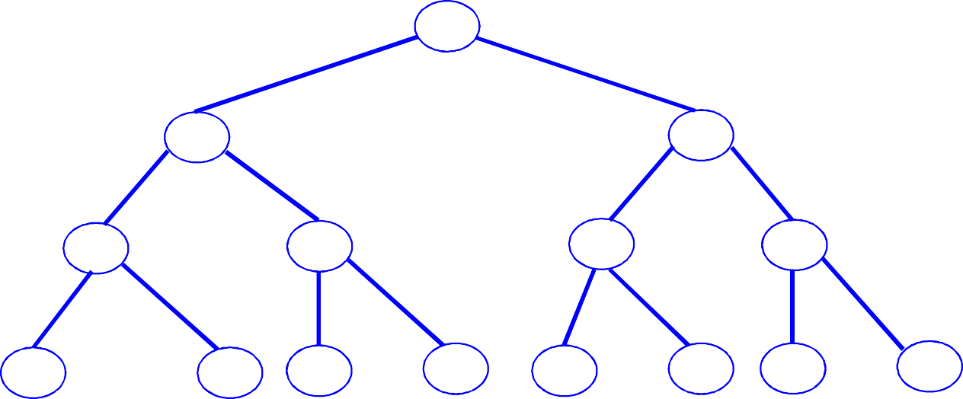
BFS Search Tree
A
B
C
S
G
S
D
E
F
A
D
B
D
A
E
C
E
S
E
S
B
B
F
Level 3
Queue = {C, E, S, E, S, B, B, F}

Slide 11
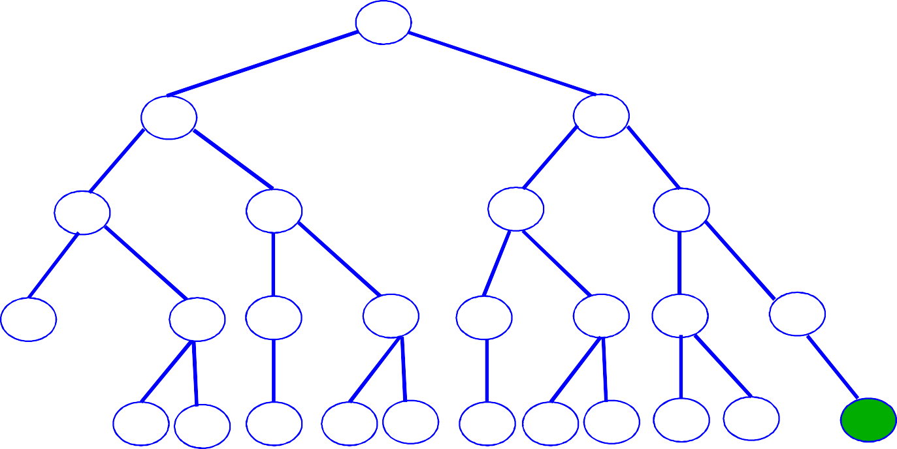
BFS Search Tree
A
B
C
S
G
S
D
E
F
A
D
B
D
A
E
C
E
S
E
S
B
B
F
D F
A B F D C E
A C
G
Level 4
Expand queue until G is at front Select G
Goal(G) = true

Slide 12
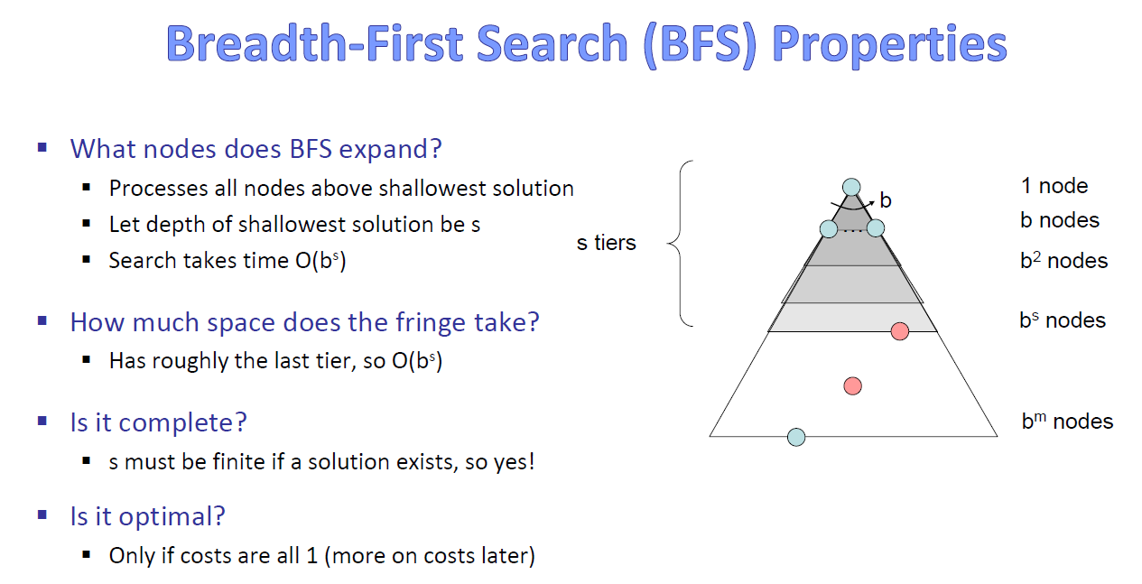
Need to store all node to trace solution path back from goal to root.

Slide 13

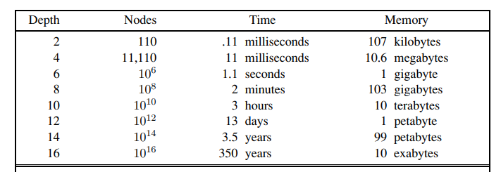
assume branching factor b = 10; processing speed 1 million nodes/second; 1000 bytes/node
Memory requirements are bigger problem than the execution time

Slide 14
Depth-First (Tree) Search
ImplemeStrategy: expand a deepest node first
ntation: Frontier is a LIFO stack
a
G
a
c
b
c
b
e
d
e
d
f
f
S
h
h
p
p
r
q
r
q
S
d
e
p
b
c
e
h
r
q
a
a
h
r
p
q
f
p
q
f
q
c
G
q
c
G
a
a

Slide 15
DFS Search Tree
A
B
C
S
G
S
D
E
F
A
D
Queue = {A,D}

Slide 16
DFS Search Tree
A
B
C
S
G
S
D
E
F
A
D
B
D
Queue = {B,D,D}

Slide 17
DFS Search Tree
A
B
C
S
G
S
D
E
F
A
D
B
D
Queue = {C,E,D,D}
C
E

Slide 18
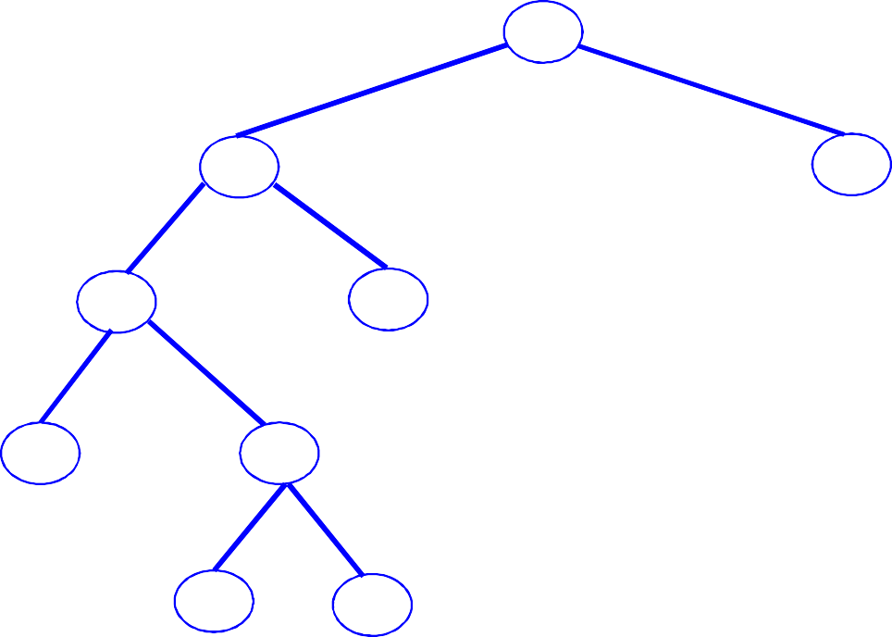
DFS Search Tree
A
B
C
S
G
S
D
E
F
A
D
B
D
Queue = {D,F,D,D}
C
E
D
F

Slide 19
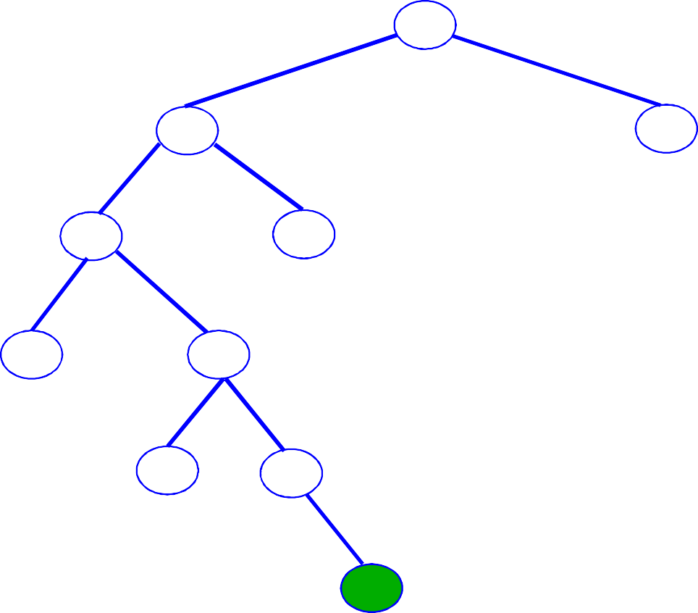
DFS Search Tree
A
B
C
S
G
S
D
E
F
A
D
B
D
Queue = {G,D,D}
C
E
D
F
G

Slide 20
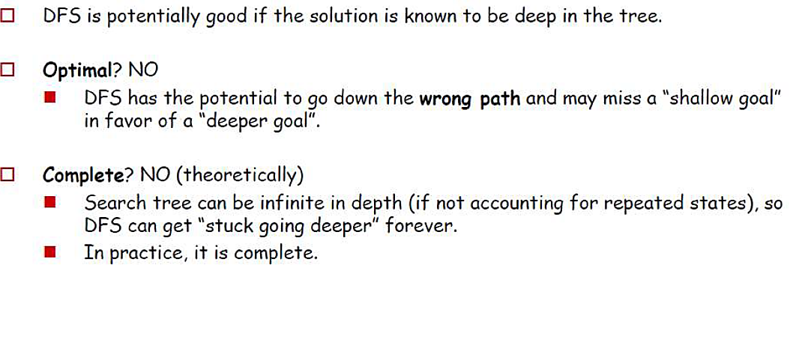
Depth First Search

Slide 21
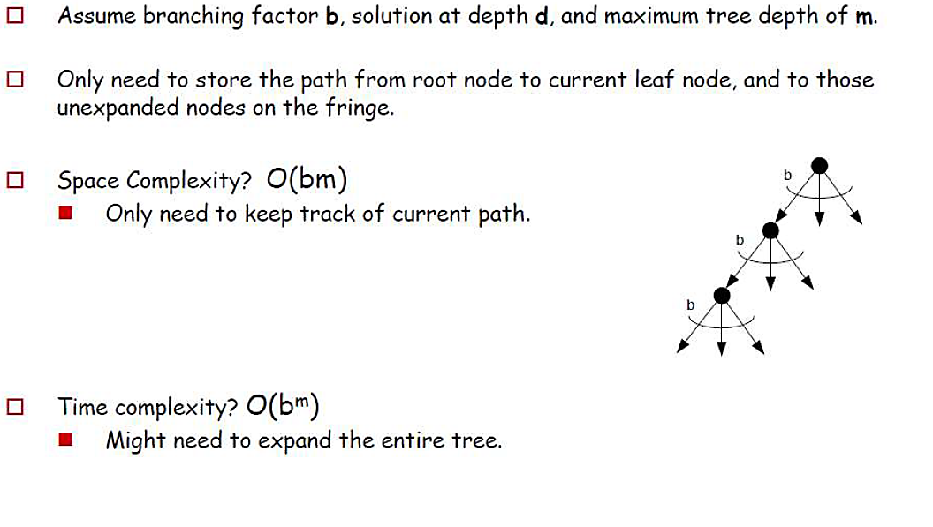
Depth First Search
In the worst case, DFS maintains b nodes at each of m depth levels on the frontier.

Slide 22
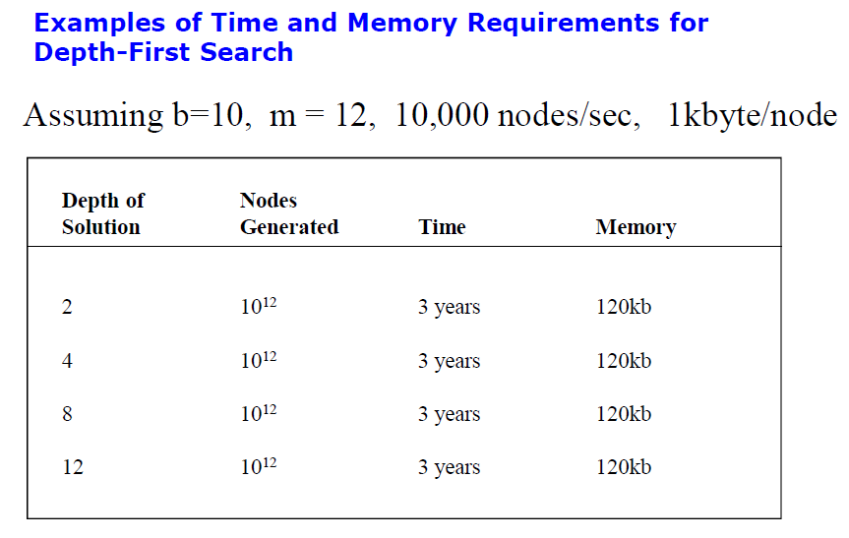
Execution time is bigger problem than the Memory

Slide 23
Comparing DFS and BFS
Aspect | Depth-First Search (DFS) | Breadth-First Search (BFS)
Strategy | Explores as far as possible along each branch before backtracking | Explores all nodes at current depth before moving to the next level
Completeness | Incomplete if cycles exist; may get stuck in infinite loops | Complete, always finds the shortest path if one exists
Optimality | Non-optimal; finds the "leftmost" solution without considering costs | Optimal; guarantees the shortest path
Time Complexity | O(b^{m}), where 'b' is the branching factor and 'm' is the maximum depth | O(b^{d}), where 'b' is the branching factor and 'd' is the depth
Space Complexity | O(bm), where 'b' is the branching factor and 'm' is the maximum depth | O(b^{d}), where 'b' is the branching factor and 'd' is the depth

Slide 24
Depth-limited search
The failure of depth-first search in infinite state spaces can be alleviated by supplying depth-first search with a predetermined depth limit l.
That is, nodes at depth l are treated as if they have no successors. This approach is called depth-limited search.
Sometimes, depth limits can be based on knowledge of the problem.
For example, on the map of Romania there are 20 cities. Therefore, we know that if there is a solution, it must be of length l = 19 at the longest, so = 19 is a possible choice.

Slide 25
Iterative Deepening Search (IDS)
Run multiple DFS searches with increasing depth-limits.
It does this by gradually increasing the limit—first 0, then 1, then 2, and so on—until a goal is found.
Iterative deepening search
○ L = 1
  While no solution, do
DFS from initial state S₀ with cutoff L If found goal,
stop and return solution,
else, increment depth limit L

Slide 26

Iterative deepening search L=0

Slide 27
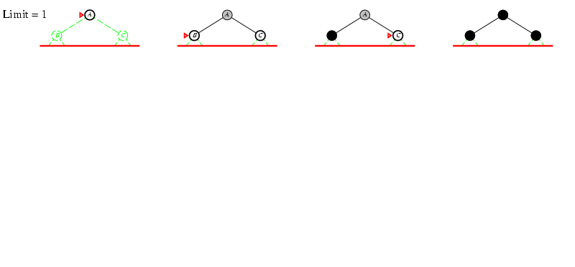
Iterative deepening search L=1

Slide 28
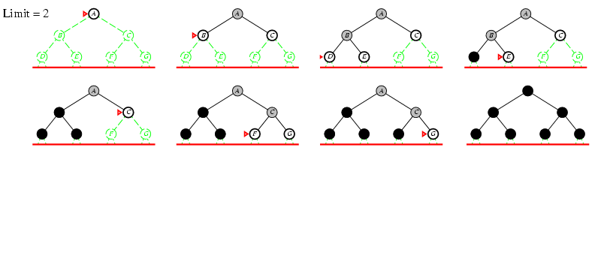
Iterative deepening search L=2

Slide 29
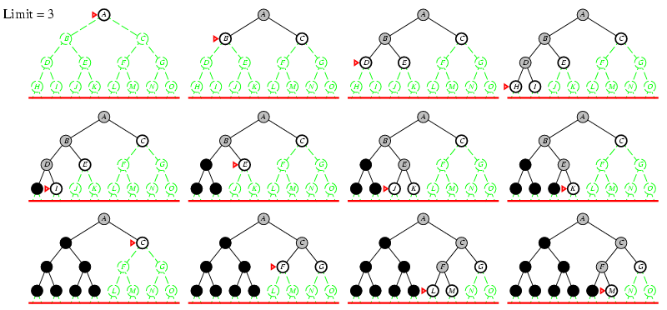
Iterative Deepening Search L=3

Slide 30
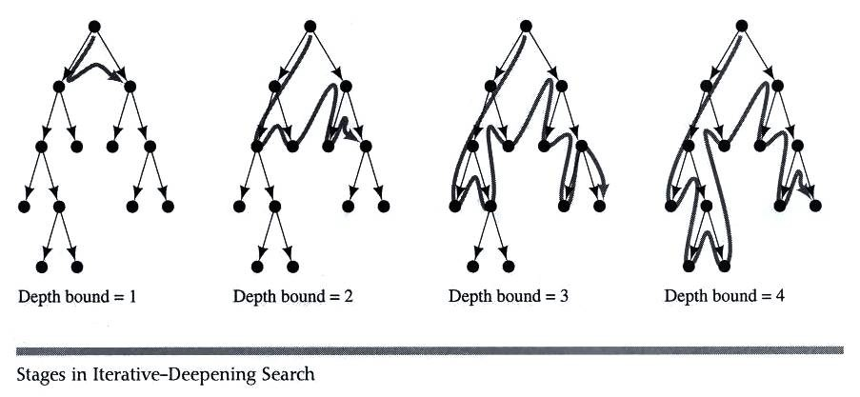
Iterative deepening search

Slide 31
Properties of Iterative Deepening Search
Space complexity = O(bd)
  (since its like depth first search run different times, with maximum depth limit d)
Time Complexity
➢ O(b^{d})
(DFS to limited depth d in the worst case)
Complete?
– Yes
Optimal
– Only if path cost is a non-decreasing function of depth

Slide 32
IDS in Practice
Isn’t IDS wasteful?
  Repeated searches on different iterations
  Compare IDS and BFS:
• E.g., b = 10 and d = 5
• N(IDS) ~ db + (d-1)b² +…… b^{d} = 123,450
• N(BFS) ~ b + b² +…… b^{d} = 111,110
    Difference is only about 10%
– Most of the time is spent at depth d, which is the same amount of time in both algorithms
In practice, IDS is the preferred uniform search method with a large search space and unknown solution depth

Slide 33
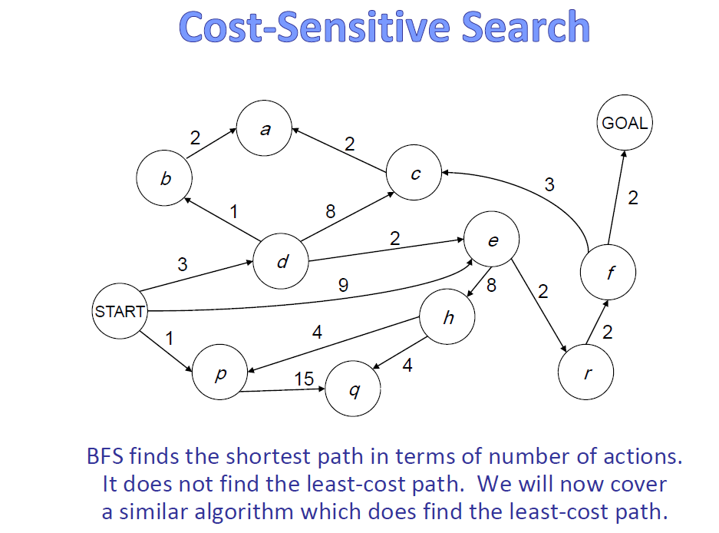

Slide 34
Uniform Cost Search
Optimality: path found = lowest cost
– Algorithms so far are only optimal under restricted circumstances
Let g(n) = cost from start state S to node n
Uniform Cost Search:
  Always expand the node on the fringe with minimum cost g(n)
  Note that if costs are equal (or almost equal) will behave similarly to BFS

Slide 35
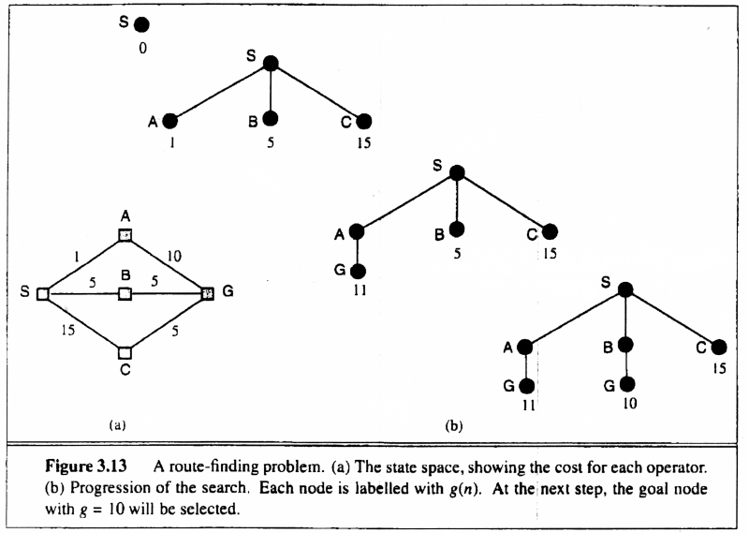
Uniform Cost Search

Slide 36
Uniform Cost (Tree) Search
2
G
a
b
1
8
c
Strategy: expand a cheapest node first:
Frontier is a priority queue (priority: cumulative cost)
2
2
3
d
e
f
9
8
2
S
h
1
1
p
q
r
15
0
S
d
3
e
9
p
1
b
4
e
5
h
17
r
11
q
16
c
11
Cost contours
a
6
a
h
13
r
7
p
q
f
p
q
f
8
q
c
G
q
c
a
11
G
10
a

Slide 37
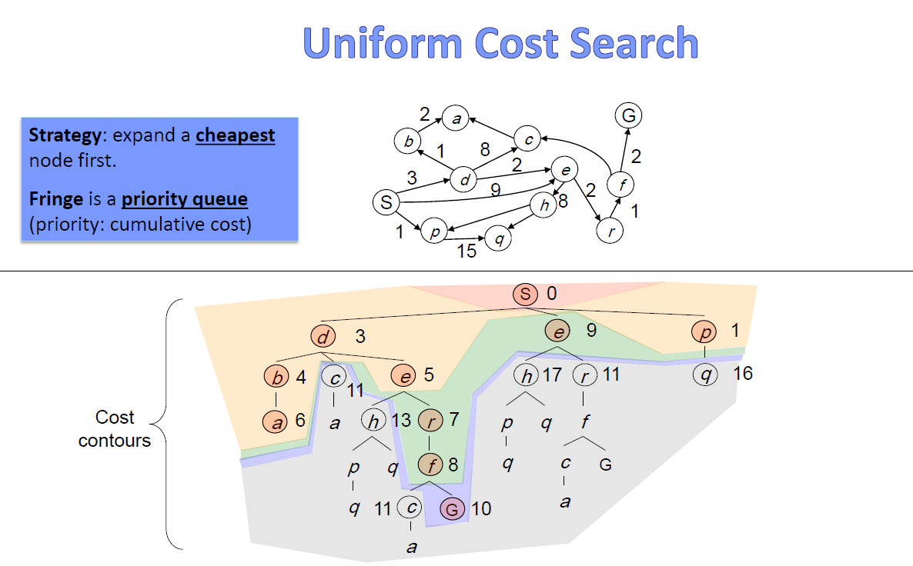

Slide 38
Uniform Cost Search (UCS) Properties
What nodes does UCS expand?
  Processes all nodes with cost less than cheapest solution!
  If that solution costs C* and arcs cost at least ε , then the “effective depth” roughly explore all nodes at depths ranging from 1 to C*/ε
  Takes time O(b^{C*/ε}) (exponential in effective depth)
How much space does the frontier take?
  the frontier will contain all nodes at the level of the cheapest solution
  Has roughly the last tier, so O(b^{C*/ε})
Is it complete?
  Assuming best solution has a finite cost and minimum arc cost is positive, yes!
Is it optimal?
  Yes! (Proof next lecture via A*)
b
c ≤ 1
…
C*/ε “tiers”
c ≤ 2
c ≤ 3

Slide 39
